Slide 5
First decentralized Cryptocurrency
Peer to Peer Technology
(No central authority or banks)
Market Cap ≅ 120 Billion
(As recorded on 02/04/2018)
Opensource
Max Supply 21 million

Slide 6
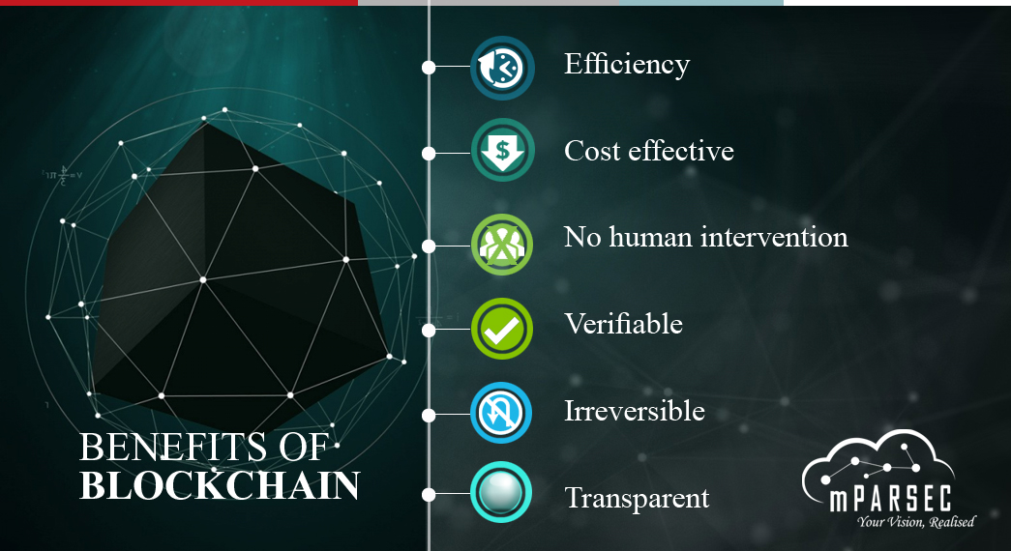

Slide 7
How Blockchain will disrupt the Current business process
Challenging the status of central banks and depositories
By streamlining crowdfunding process using ICOs
Best digital solution to not only store Asset (Cryptocurrencies) but also data (Identity, Voting etc)
Challenger of mediation System (No human intervention)
Cost efficient (P2P remittance, Payment and transaction markets)

Slide 8
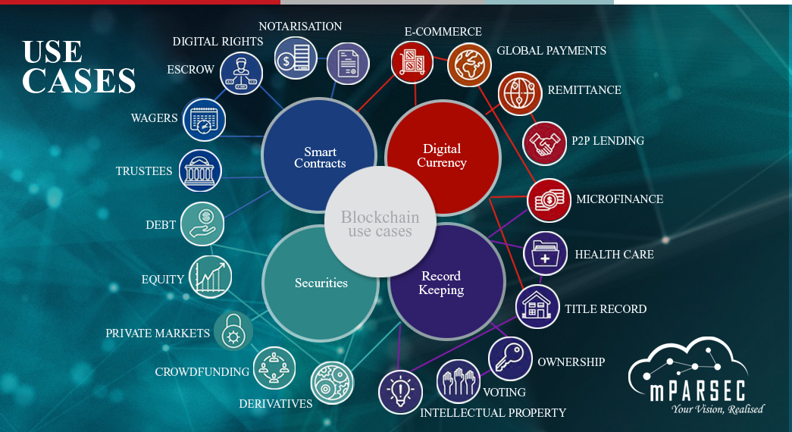

Slide 9
Tech Giants based on winner takes all model has influence based on data or established market.
DAO
(Decentralized Autonomous Organizations)
DAO execute tasks without human intervention along with required checks and balances .
Creating a blockchain based Facebook will give users control of their data and social interactions and they can monetize (e.g. Data of Facebook Users has been harvested and manipulated by Cambridge Analytica).
A blockchain based google (User behavior’s Data) will give User’s monetization of their data generated while browsing.
A blockchain based Amazon with autonomous system of connecting seller, buyers and logistics companies along with a effective rating systems.
A blockchain based Uber will connect drivers and riders
through a transparent mechanism

Slide 11
Brink of fourth industrial revolution (AI, Robotics, Internet of things, Autonomous vehicles, 3D printing, Nanotechnology, Biotechnology, Quantum computing and Blockchain)
Job market disruption
Positive Feedback loop / Exponential change
Income disparity
Alternatives?
FOURTH INDUSTRIAL REVOLUTION
Social Enterprises / Cooperatives powered by blockchain
Monetization of User data and interaction

Slide 12
FACTORS FOR EARLY ADOPTION IN PAKISTAN
Transparency International Corruption Index- 117 out of 180.
Very conservative estimate is that over 30% of the economy is dark.
Strong network effect and Trend following will lead to rapid adoption of cryptocurrencies.
Massive acceptance in a short time can lead to lost monitory controls and if coupled with a big trigger event can potentially lead to hyper inflation.
Early adopters can be
Police
Judiciary
Land Records Management
Procurement
Cross-border traders

