Slide 1
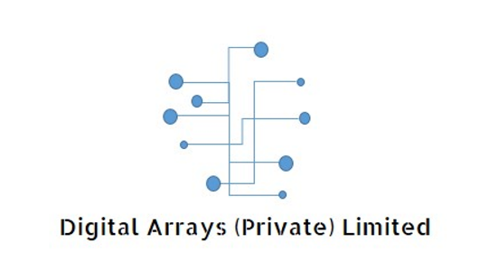
Blockchain and Cyber Security

Slide 2
Why USE or implement ICT ?
What is Competitive Advantage ?
What is T R A N S F O R M A T I O N ?
What is D I S R U P T I O N ?
What is BIG DATA !

Slide 3
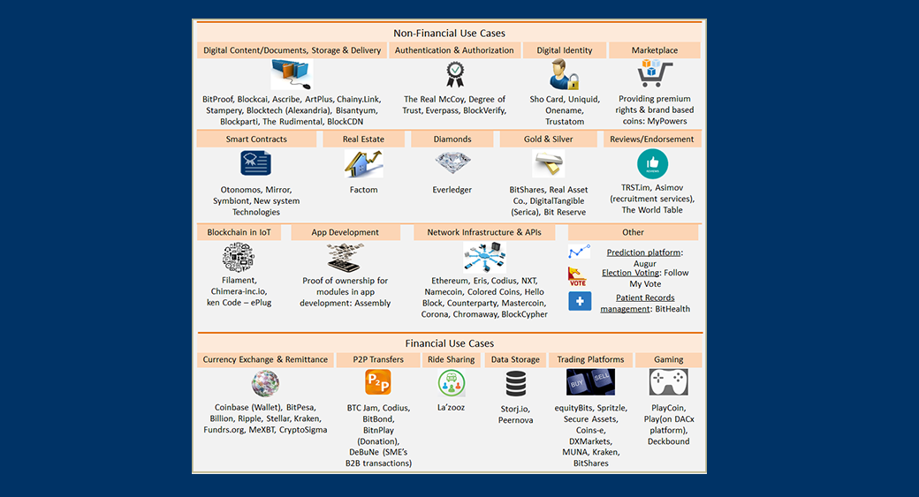

Slide 5
Monetary System
What if SBP/Govt. declares “No More Money Making”
Currency printing correlated with production of OLIVES
Max number of BITCOINS ?
How many BITCOINS exist ?
17 million OR 21 million
What is the significance of year 2140 and of 2020
Power consumption of Denmark / New Zealand / Ireland

Slide 6
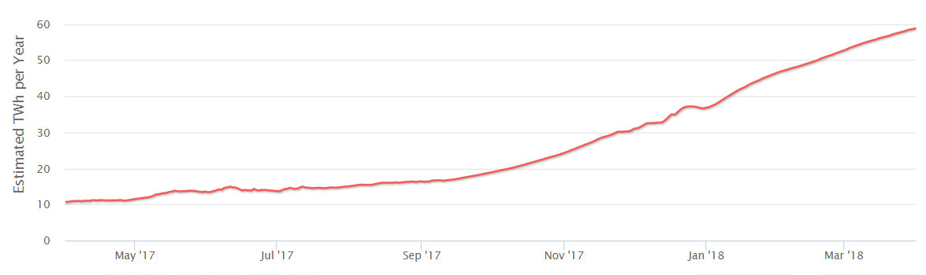
Bitcoin Energy Consumption
>50% control of hash rate with 3-4 miners
< 20 mining entities
44 place if ranked among countries’ power consumption

Slide 7
Distributed Ledger Technology
Record of events, once entered cannot be altered or deleted
Powerful aspect is the barrier to tampering or deleting
1)cost-efficient, 2) secure and 3) quicker
Historical and current ownership of high-value items.
CONTROL of Blockchain:
  1) Permissioned;
  2) Permission less

Slide 8
Components of DLT
1. Block; 2. Chain; 3. Network
Time bound collection of data that is published into a ledger within a given period
Data is gathered into a block periodically
Factom period is 10 minutes; Ethereum period is 15 seconds
Block is made of ENTRIES

Slide 9
Chain
Collection of blocks that are linked together referencing hashes from the previous block
HASH is mathematical glue and creates trust
Network
Network consists of computers
Nodes are computers or systems operating on a larger network.

Slide 10
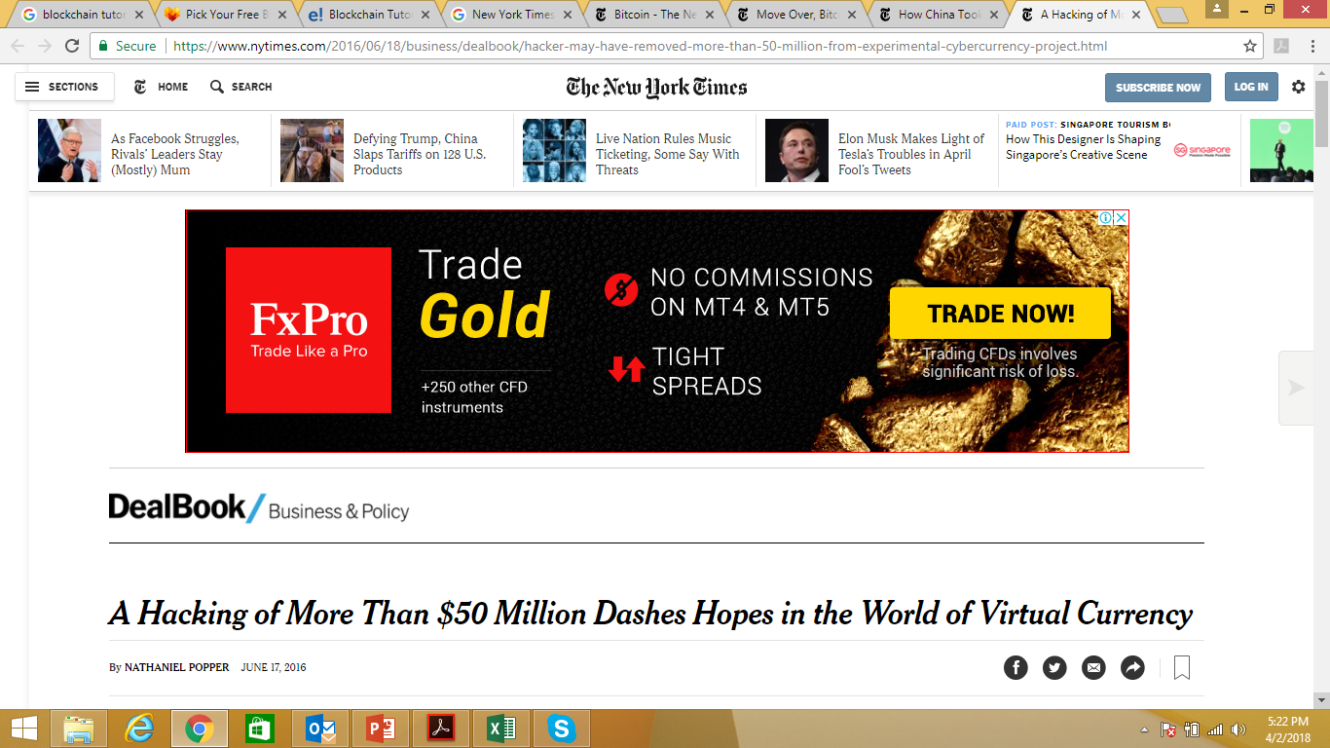
Ethereum Hacked
R3 Consortium
evaluating
private version of Ethereum Netowrk

Slide 11
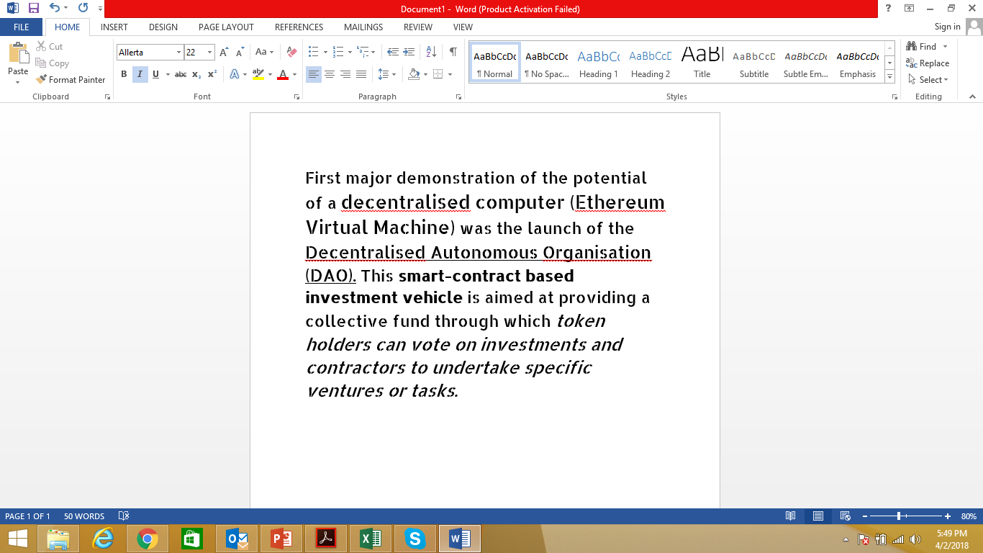
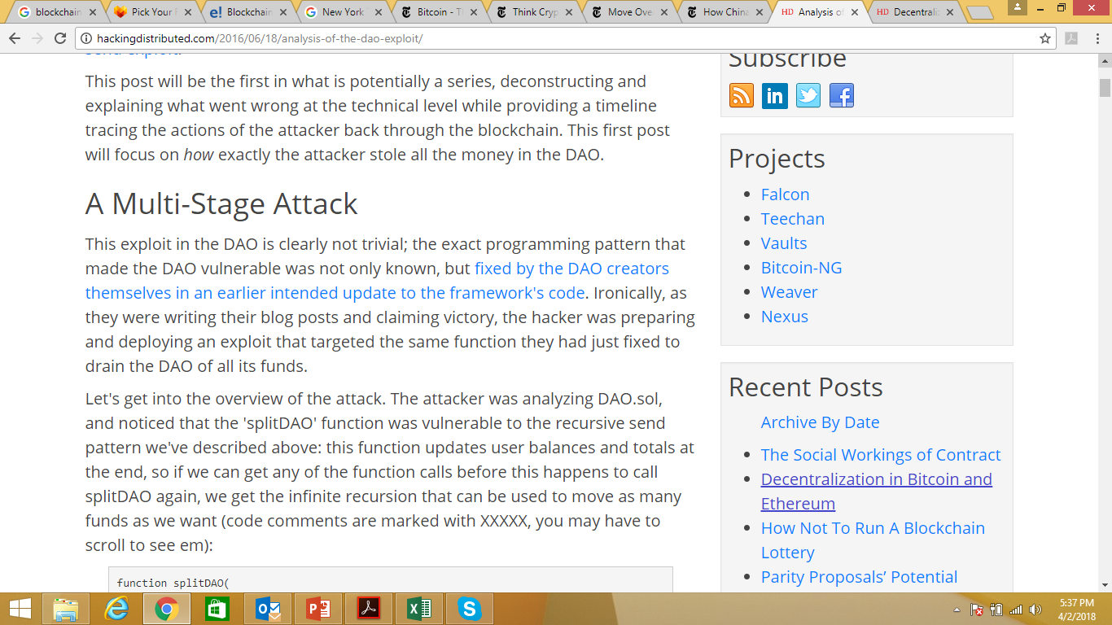


Slide 12
DAO HAck
Token sale (similar to IPO) in May 2016, the DAO raised over 11.5 Million Ether (equivalent to over €140 million).
June 17th 2016, the DAO suffered “recursive split.”
Investors can choose to separate from the existing vehicle and take their funds with them.
Split function occurred, initiating a withdrawal.
Blocked the call to function to update the balance

Slide 13


Slide 14
Challenges
Key Management
Private key compromise
Limitless attacks on cipher-text, off the network
Privacy in permissionless ledger- all entities may see the history
Right to be forgotten – difficult to vouch on all nodes
Source Code Review
Consensus Hi-jacking

Slide 15
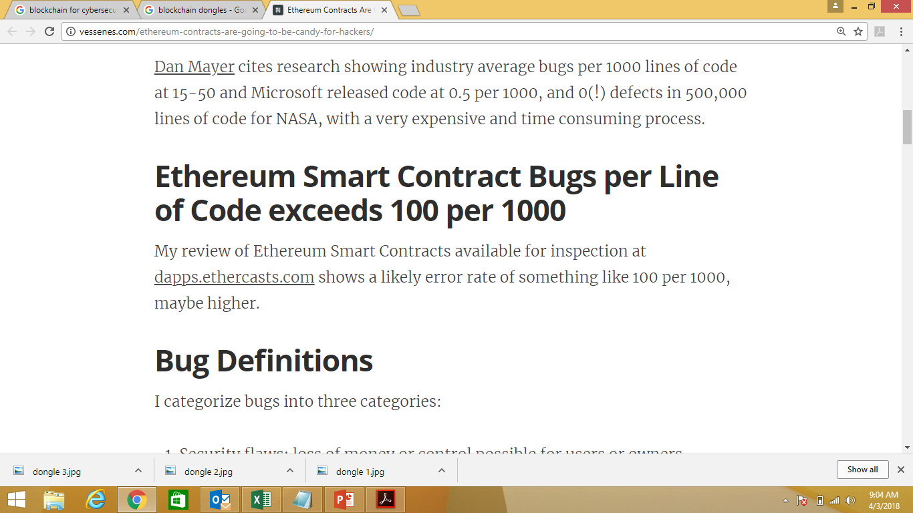
Challenges
Exploiting Permissioned Blockchains - Compromise single entity
DDOS - rogue wallets pushing spam transactions
BITCOIN-March 2016-one wallet pushing Tx with higher fee
Hide malicious data just like off-shore companies
Scalability- BT > 150GB, ETH > 15GB
Interoperability

Slide 16
Summary

Slide 17

Queries
M.Asif.Riaz@digital-arrays.com

