Slide 1
Sadia Nazim Keshwani
Modern Data Platform
3 April 2018
Sales Manager, GBM Pakistan

Slide 2
Organizations are Getting Dumber

Slide 3
Organizations are Getting Dumber
Data
Available Data
Enterprise
Amnesia
Understood Data
Time

Slide 4

Do you remember this supplier in 2007?

Slide 5

“The ‘Uber syndrome’ – where a competitor with a completely different business model enters your industry and flattens you.”
CIO, Transportation, United States
What’s putting the world’s top executives on edge?
4
©2015 IBM Corporation

Slide 6







A New Era of Computing has Emerged
Cognitive Era
Smarter Planet
E-Business
Distributed
Computing
Big Data &
Predictive Analytics
Centralized
Mainframes
Cognitive
Data Warehousing
Office Productivity
Client/
Server
Personal Computer
Data
Reporting
Context
Insight
Transactional Database
Business Intelligence
Big Data &
Advanced Analytics
Actionable Insight in context

Slide 7

Infrastructure Matters in this Landscape
BUSINESS VALUE
PERFORMANCE
Cognitive
2015
Deep Learning
Variety / Volume of Data
Cognitive
Learn Dynamically
HPDA
GPU/FPGA cores bulk process tasks in parallel - far more efficient for many data-intensive
Machine Learning
2006
Predictive
What Could Happen?
BIG DATA
1990
Store massive volumes of data becomes more affordable and scalable for performance
Prescriptive
Best Outcomes?
DATA WAREHOUSE
Descriptive
What Has Happened?
Store and analyse growing volumes of data on high performance machines with ACID

Slide 8
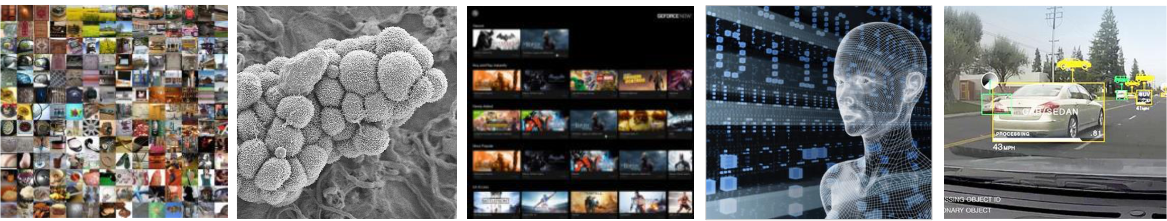
Artificial Intelligence Is Everywhere
INTERNET
& CLOUD
Image Classification Speech Recognition Language Translation Language Processing Sentiment Analysis Recommendation
MEDICINE
& BIOLOGY
Cancer Cell Detection Diabetic Grading Drug Discovery
MEDIA
& ENTERTAINMENT
Video Captioning Video Search Real Time Translation
SECURITY & DEFENSE
Face Detection Video Surveillance Satellite Imagery
AUTONOMOUS MACHINES
Pedestrian Detection Lane Tracking Recognize Traffic Sign

Slide 9

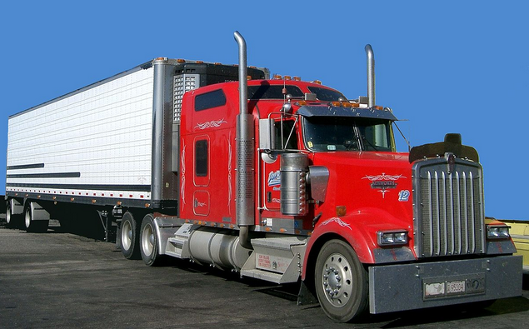
In a drag race which vehicle will reach 1km distance first?
A
B

Slide 10

Which Vehicle will reach 1km distance first?
With 10 Tons of Cargo
A
B

Slide 11
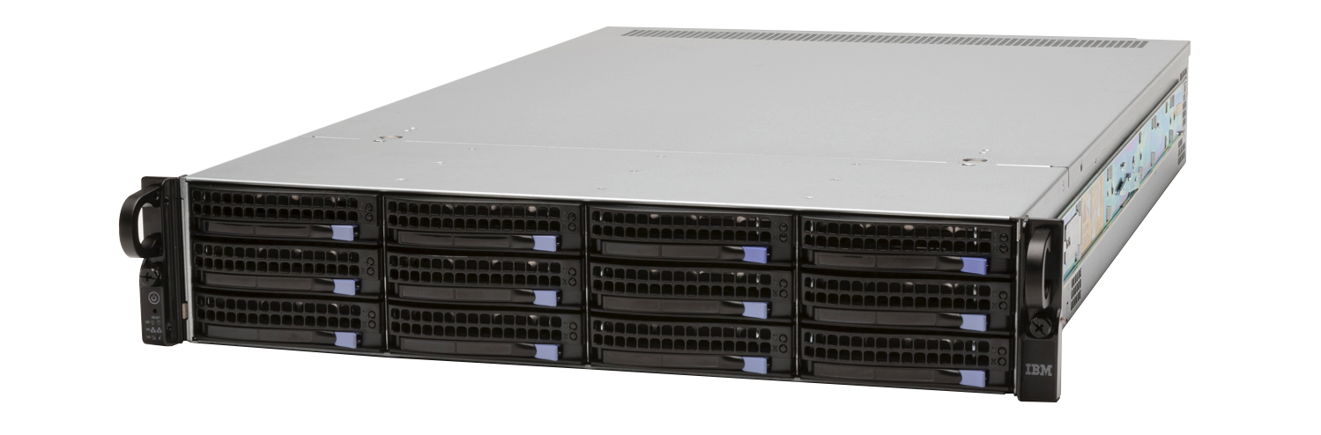


IBM Power Systems
an accelerated
platform for
cognitive computing
+
MORE
BETTER
vs.
x86
processor cache
threads per core
memory bandwidth
open innovation
+++
availability
scalability
reliability
serviceability

Slide 12
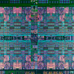



Balanced Systems Designed for Cognitive
Power high-performance core, bandwidth, accelerator differentiation
CAPI
NVLink
PCIe Gen3
OpenCAPI
NVLink 2.0
PCIe Gen4
P8
P9
P8
High Performance Cores
Fast & Large
Memory System
Fast PowerAccel Interconnects for Accelerators
Faster PowerAccel Interconnect for Accelerators
>2X vs. Intel
4-5X Memory Bandwidth
3X Cache vs. Intel
NVLink 1.0
5x vs. Intel
OpenCAPI / NVLink 2.0
9.5x vs. Intel
Power partnerships with accelerator industry players:
Nvidia GPU, Xilinx, AMD GPU, open to other options

Slide 13











Power Use Cases
Financial Services
Fraud detection
Risk management
360° View of the Customer
Utilities
Weather impact analysis on power generation
Transmission monitoring
Smart grid management
Transportation
Weather and traffic impact on logistics and fuel consumption
IT
Transition log analysis for multiple transactional systems
Cybersecurity
Health & Life Sciences
Epidemic early warning system
ICU monitoring
Remote healthcare monitoring
Retail
360° View of the Customer
Click-stream analysis
Real-time promotions
Telecommunications
CDR processing
Churn prediction
Geomapping / marketing
Network monitoring
Law Enforcement
Real-time multimodal surveillance
Situational awareness
Cyber security detection

Slide 14
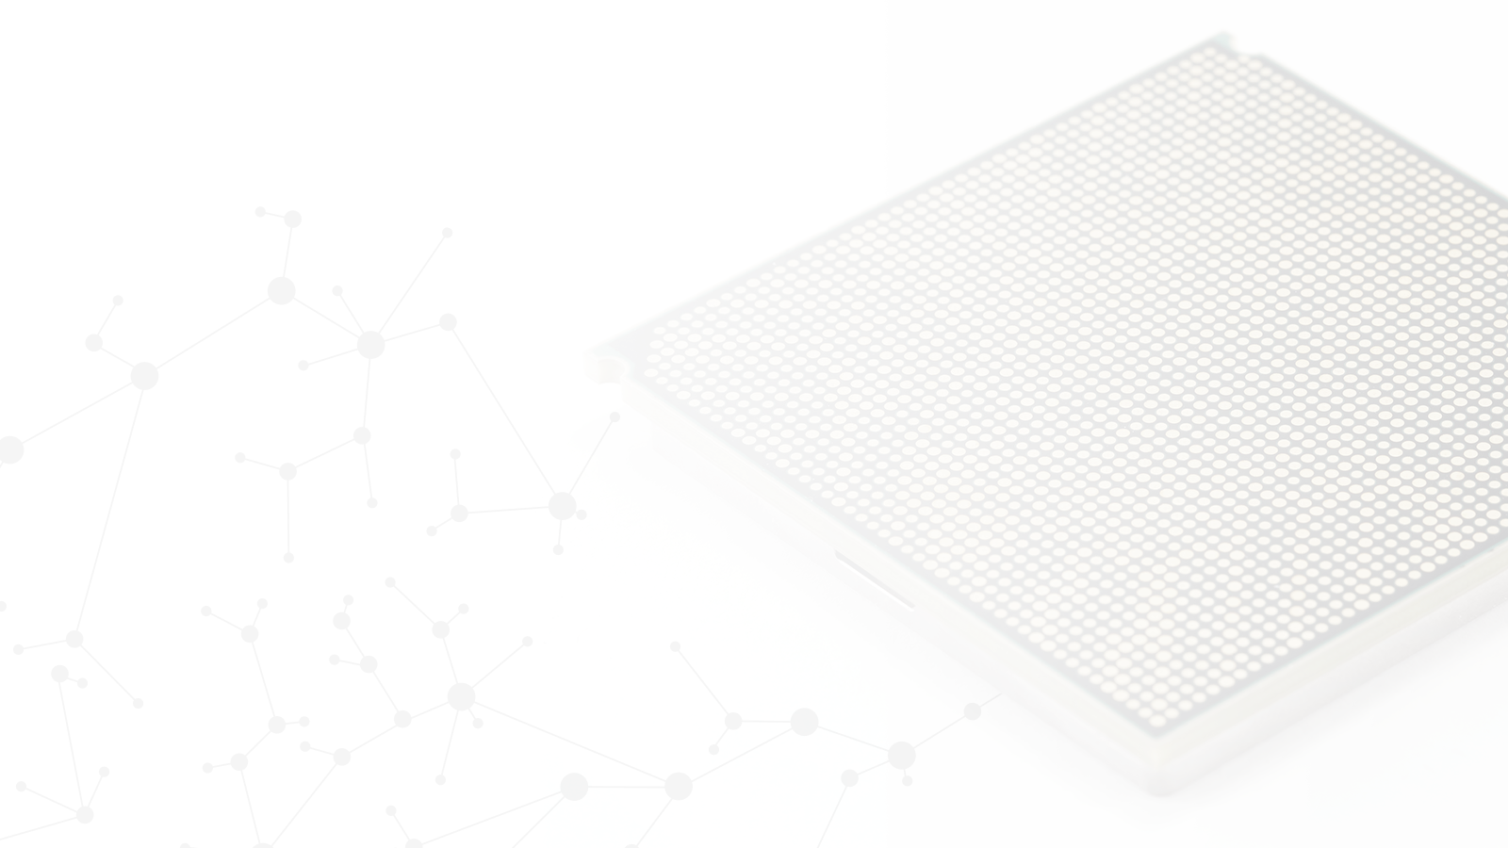
POWER9
An acceleration superhighway.
The only processor specifically designed for the AI era.
4x
9.5x
2.6x
1st
Threads per core vs x86
Up to 9.5x more I/O bandwidth than x86
More RAM possible vs. x86
CPU to deliver PCIe gen 4

Slide 15


The New POWER9 Processor
Enhanced Core and Chip Architecture for Emerging Workloads
• New Core Optimized for Emerging Algorithms to Interpret and Reason
• Bandwidth, Scale, and Capacity, to Ingest and Analyze
Processor Family with Scale-Out and Scale-Up
• Enabling a Range of Platform Optimizations
• Extreme Virtualization Capabilities for the Cloud
Premier Acceleration Platform
• Heterogeneous Compute Options to Enable New Application Paradigms
• State of the Art I/O
• Engineered to be Open

Slide 16

IBM | Open POWER Advantage
IBM
OpenPOWER
Foundation
Open Source
Software

Slide 17






















































































300+ OpenPOWER Foundation Members
Implementation, HPC & Research
Software
System Integration
I/O, Storage & Acceleration
Boards & Systems
Chips & SoCs

Slide 18








Leading Open Source DBs Available & Optimized for Linux on Power
MongoDB EnterpriseDB Neo4j MariaDB Spark Hadoop | RedisLabs PostgreSQL Cassandra MySQL IBM BigInsights Hortonworks
*

Slide 19



Why move to POWER9
Deliver better TCO (HW and SW) with an open, more flexible data infrastructure
Up to 1.5x Performance per core vs. P8*
Better TCO for your infrastructure
Deploy more workloads
Performance per core leadership
Cloud ready
Optimize your infrastructure
Deploy more workloads quickly
Technology leadership for a future forward infrastructure.
PCIe Gen4
25 GB/s high speed links
Extends POWER’s HANA advantage
Up to 4 TB in a two-socket system, 33% more than x86. Industry standard DIMMs/pricing
* Certification expected 2Q from SAP
Flexibility - x86 heavily restricted in virtualized environments
Resiliency - Failures of x86 servers often cited as reasons for delays in HANA ‘go-live’ projects. SAP Support loves Power for HANA
Performance – Clients migrating from HANA on x86 to Power are reporting at least 2x better performance on POWER8
Performance per core leadership *
Save on software costs priced by the core
Cloud ready
Seamlessly run Linux workloads
in a PowerVC Cloud
* Based on IBM internal testing & projections as of 2.5.18; Initial testing indicates relative performance ratios between 1.2 to 1.5X for POWER8 to POWER9.

Slide 20
Power 9 Fits your Business
Business challenges |  | Business benefits
Ongoing security threats |  | POWER9 will come with all critical security fixes delivered and turned on by default
Maximize performance and usage of SAP HANA |  | Large 4TB memory footprint gives a competitive advantage and exploits current SAP HANA licenses better than x86
How to leverage AI and Cognitive |  | Db2 on IBM i and Watson can work seamlessly together with secure APIs and connectors
TCA and TCO for CIOs |  | POWER9 delivers great price/ performance and can be managed with much lesser resources than x86

Slide 21
…. your benefits
Unlock the value of your data and deliver insights faster with Modern Platform solutions
Easy integration into your cloud & cognitive strategy
Designed for mission critical enterprise workloads

Slide 22
So time is here...

Slide 23


Slide 24
Thank You

