Slide 1
Future of CIO

Slide 2
Future of CIO is CEO

Slide 3
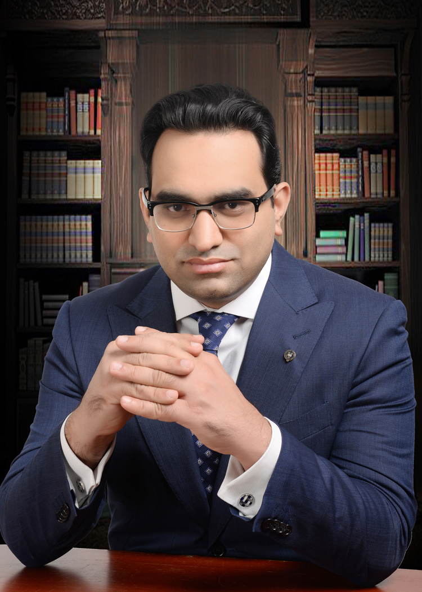
asad@auctechnologies.com
asadullahchaudhryfan
@asadullahfan
+92 300 214 4514

