Slide 1
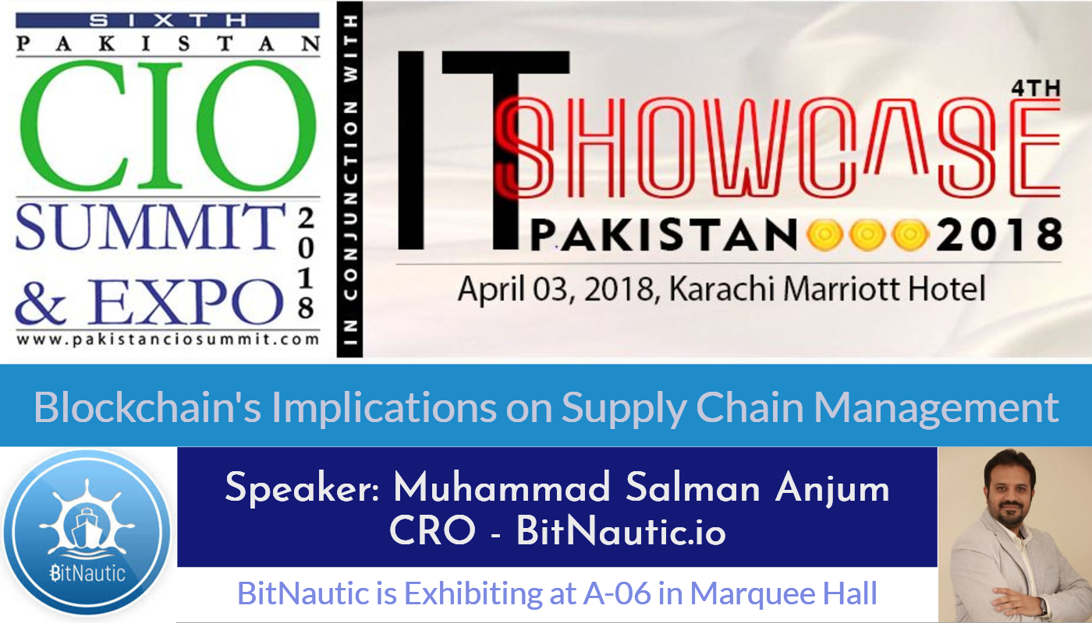

Slide 2
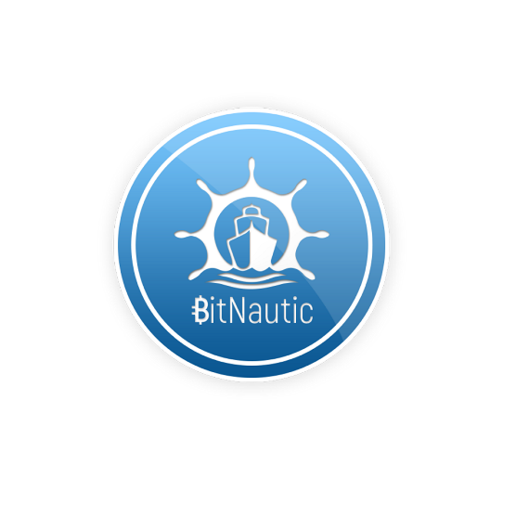
www.bitnautic.io

Slide 3
Supply Chain Management in Blockchain Era
Block 1
What’s In It?
www.bitnautic.io

Slide 4
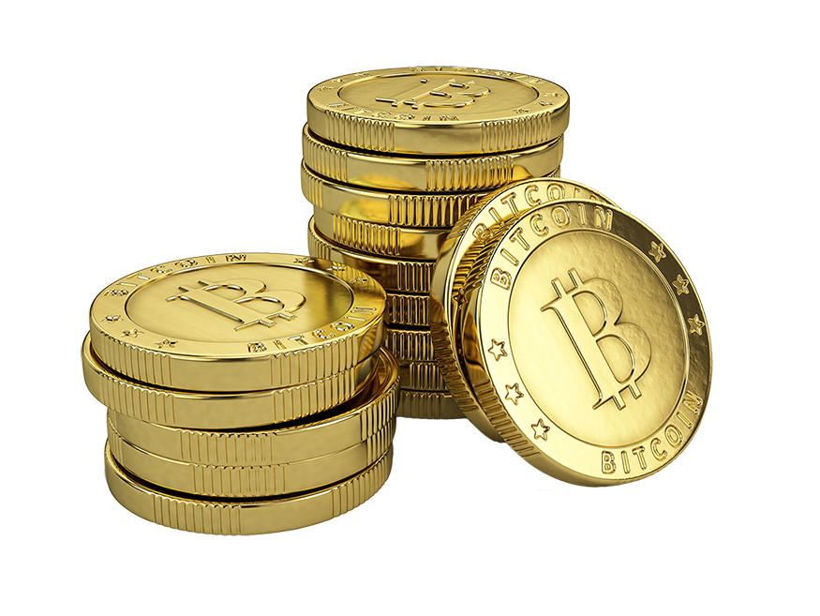
What’s Not In It
Notes:
When we hear about BC – what’s the next word or concept comes to your mind? Cryptocurrency
Nuts & Bolts of BC Technical side – more on strategic side

Slide 5
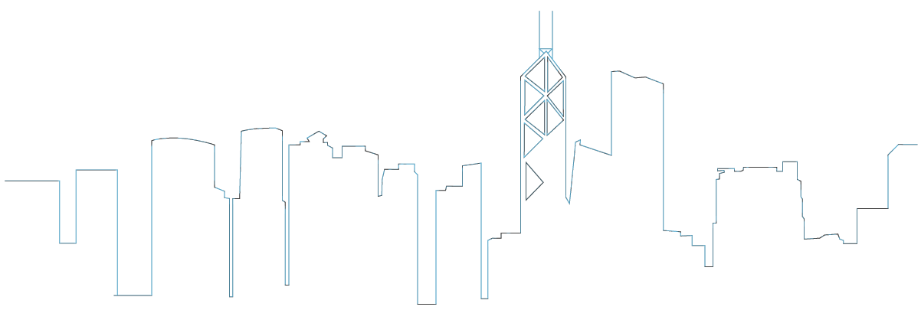
What’s In It
Notes:
We’ll see the applications of BC in world of work –
In specific in Banks & Financial industry space
The objective is to provide fruit for thought for coming up with start up/innovation lab for getting into BC bandwagon
And up-skill you guys with contemporary technology to take it from BUZZ word to Lines of Business

Slide 6
Chain of Discussion
Orientation of Blockchain
Why Blockchain
Implications of Blockchain on Islamic Banking
Challenges & Trends in Blockchain
Notes:
3 Parts:
Orientation on Blockchain
Orientation on Islamic Banking
Implications of Blockchain in Islamic Banking & Finance

Slide 7
Supply Chain Management in Blockchain Era
Block 2
Unlocking Blockchain
www.bitnautic.io

Slide 8
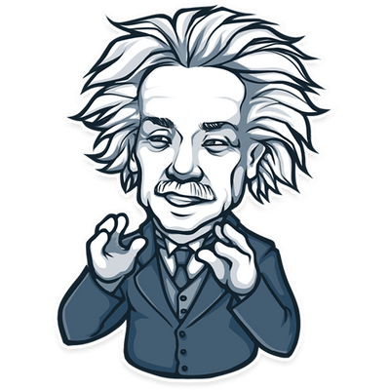
Understanding Blockchain
If you can't explain it simply, you don't understand it well enough!

Slide 9
Understanding Blockchain – World without Blockchain
01A2H
JA3O1
9LWM2
6F4J3
4IUYT

Slide 10
Understanding Blockchain – World with Blockchain
01A2H
JA3O1
9LWM2
6F4J3
4IUYT

Slide 11
Understanding Blockchain – World without Blockchain
01A2H
JA3O1
9LWM2
6F4J3
4IUYT
01A2H
JA3O1
9LWM2
6F4J3
4IUYT
01A2H
JA3O1
9LWM2
6F4J3
4IUYT
01A2H
JA3O1
9LWM2
6F4J3
4IUYT
01A2H
JA3O1
9LWM2
6F4J3
4IUYT
01A2H
JA3O1
9LWM2
6F4J3
4IUYT
01A2H
JA3O1
9LWM2
6F4J3
4IUYT

Slide 12
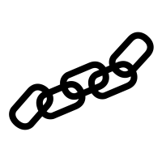
Understanding Blockchain – World without Blockchain
Decentralized
01A2H
JA3O1
9LWM2
6F4J3
4IUYT
01A2H
JA3O1
9LWM2
6F4J3
4IUYT
01A2H
JA3O1
9LWM2
6F4J3
4IUYT
Traceability
Transparency
Trust
Digital Database
01A2H
JA3O1
9LWM2
6F4J3
4IUYT
Chained/Connected
01A2H
JA3O1
9LWM2
6F4J3
4IUYT
Distributed
Consolidated
Coded
01A2H
JA3O1
9LWM2
6F4J3
4IUYT
01A2H
JA3O1
9LWM2
6F4J3
4IUYT

Slide 13
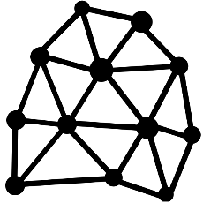
Blockchain: Combo of Existing Technologies
04
03
Distributed
02
Timestamping
01
Cryptography
P2P Networking
Notes:
P2P Networking
Timestamping
Cryptography
Etc. 5 in total from eds course

Slide 14
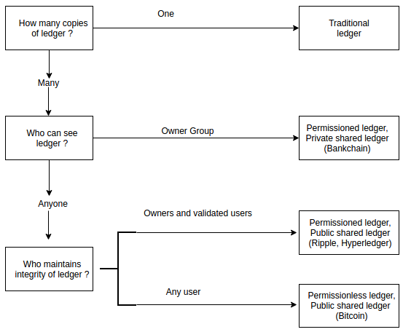
Types of Blockchain
Notes:
P2P Networking
Timestamping
Cryptography
Etc. 5 in total from eds course

Slide 15
Supply Chain Management in Blockchain Era
Block 3
Why Blockchain?
www.bitnautic.io

Slide 16
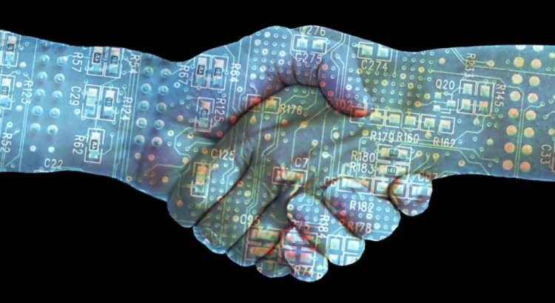
Primary Value of Blockchain
Giant Platform of Trust
Notes:
Put simply (with Bank of England’s words), the blockchain is “a technology that allows people who don’t know each other to trust a shared record of events”.

Slide 17
Blockchain for Supply Chain Management
A Perfect Match or Mismatch
Notes:
The characteristics of the banking industry—and also the broader financial industry—align very well with the capabilities of the blockchain.
Data sharing among multiple actors and Touchpoints powers the financial world.
Everything about the blockchain touches the core of banking. This is why it will be a challenging encounter.
From booking to arrival, players can include airlines, online travel platforms, card providers, airports, immigration, government, hotels, car rental agencies and more.
Each actor requires, collects, stores and often shares traveler and operational information. In fact, a web of complex and seemingly endless data reconciliation is happening behind the scenes of every touchpoint of every traveler’s trip.
With so many systems in play—airlines alone house data in many isolated systems from passenger service to crew management—data exchange is not always smooth. And in the airlines industry, not only are operational integrity and revenue generation at stake when something goes wrong, but so is safety and security.
Security is one reason they are a good fit – blockchain’s encrypted and trustless nature makes it a viable option when it comes to keeping the ever-growing number of connected devices in our homes and offices safe.

Slide 18
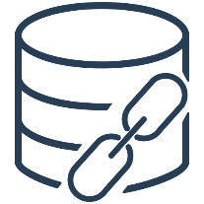
Blockchain Key Features & Supply Chain Management
01
02
03
04
Disintermediation
Resilience
Integrity
Traceability
Notes:
A Match made in heavens

Slide 19
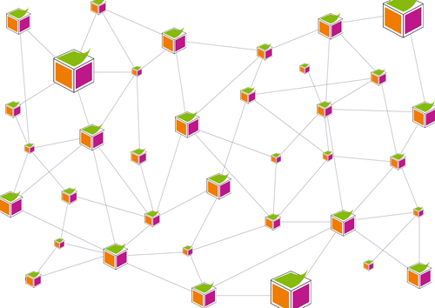
Blockchain Applications in World of Work
Supply Chain
Finance
Music
Fraud Prevention
Governance
Healthcare
People Management
Education
Notes:
World Economic Forum

Slide 20
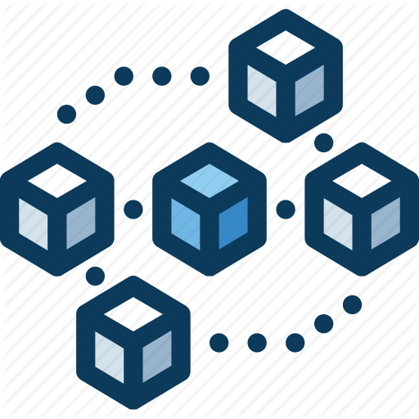
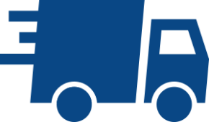
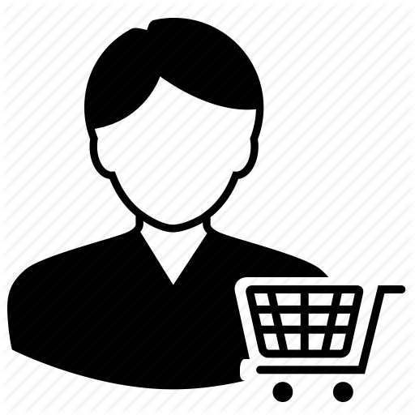
Blockchain Application for Supply Chain Management
Supplier | Producer | Distributor/3PL | Retailer | Customer
Data about origin on raw materials | Process validation | Receives notification about receipt of finished goods | Transparency on full delivery time | Scans QR code via app
Smart Contracts | Timestamps | Temperature & conditions of goods | Adapts orders, promos etc. accordingly | Gets insights into product journey
 | QR code to packaging | Status tracking | Visibility to all suppliers | Earns points in cross-company loyalty program
Notes:
blockchain-enabled track and trace technology
At the crux of the product is blockchain-enabled track and trace technology, which helps manufacturers with complex supply chains ensure that products are traceable at every node.

Slide 21
Blockchain Benefits for Supply Chain Management
Regulatory Compliance
Efficient Sharing of Information
Blockchain
Benefits for Islamic Banking
Asset Value
Management
Low Cost
Record Keeping
Fruad Prevention
Standardization of Data
Notes:
allows for tracking and tracing goods at every point of the supply chain. Enabling all of this technology together reduces stock wastage, increases efficiency and allows companies to have greater control over their supply chains.

Slide 22
Supply Chain Management in Blockchain Era
Block 4
Blockchain Use Cases in Supply Chain Management
www.bitnautic.io

Slide 23
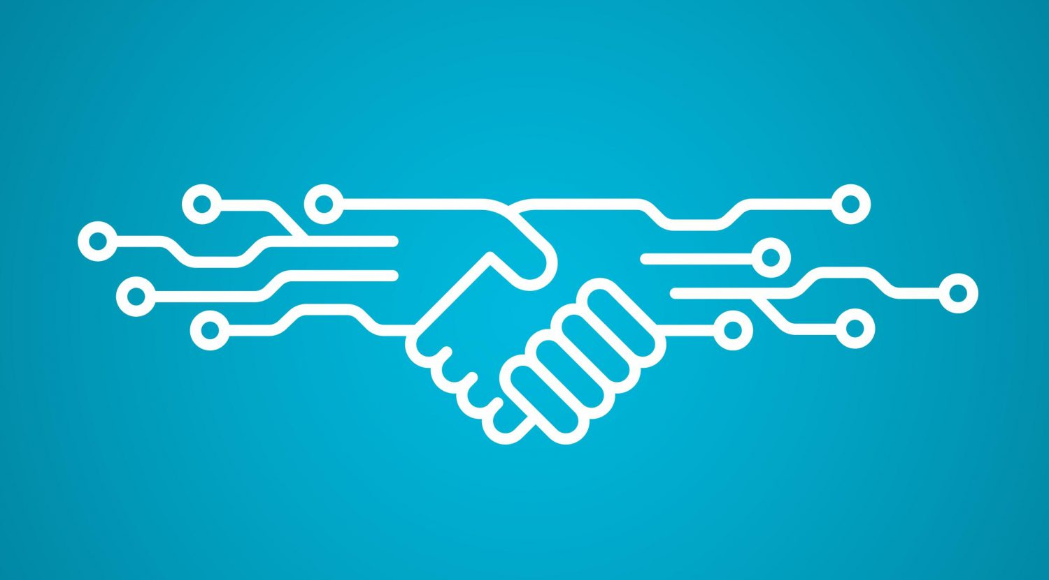
Smart Contracts
A smart contract is a computer protocol intended to facilitate, verify, or enforce the negotiation or performance of a contract.
It defines the conditions to which all parties using contract agrees. So if required conditions are met certain actions are executed.
Notes:
Through smart contracts automation of the entire contractual process for Islamic institutions, alleviating the additional administrative and legal complexities and redundancies associated with Sharia-compliant financial products

Slide 24
Blockchain of Things (BoT)
BLOCKCHAIN
Notes:
US blockchain company Skuchain has partnered with Japanese tech giant NTT Data to build a blockchain platform for supply chain and logistics management.

Slide 25
Food Chain on Blockchain

Slide 26
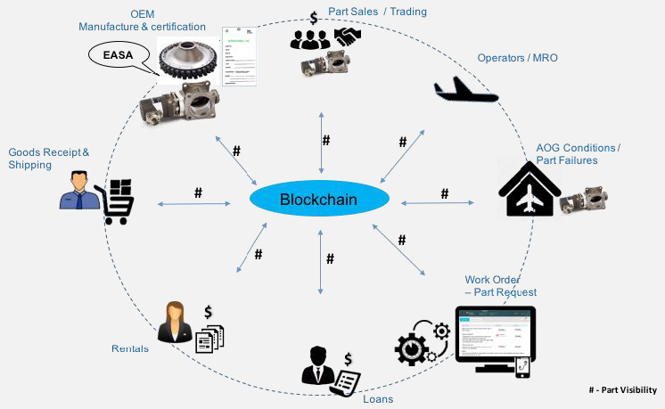
Aviation MRO (Maintenance, Overhaul & Repair)

Slide 27
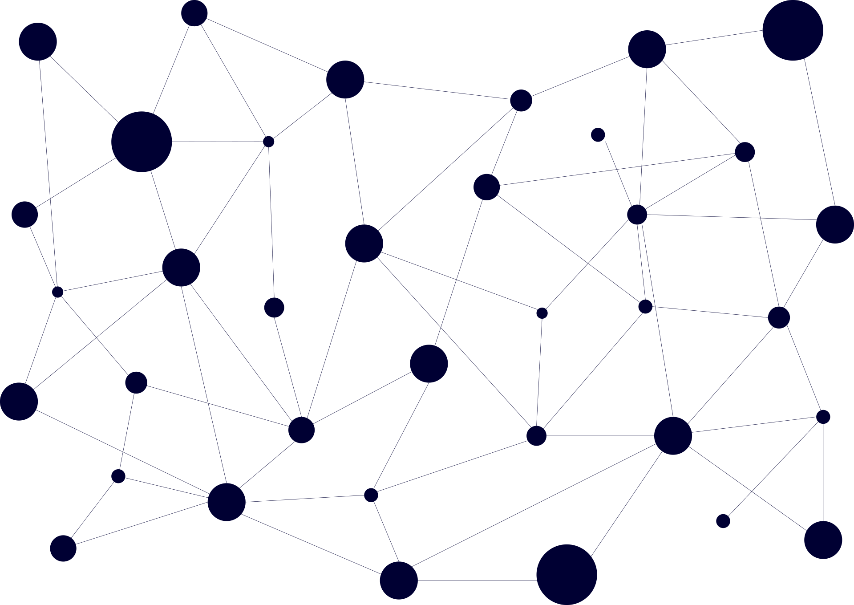
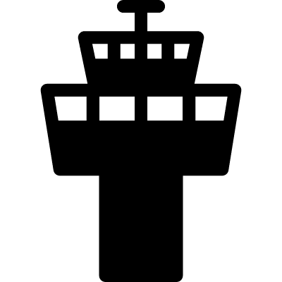
Aviation Collaborative Decision Making on Blockchain
Airport
Operations
Air Traffic Control Tower
Central Flow
Management
Unit
Ground
Handling
Aircraft
Operators
Perfect ground for a consortium blockchain where each party would write to the chain & allow each party to see a true picture of what is happening in near real time at an airport

Slide 28
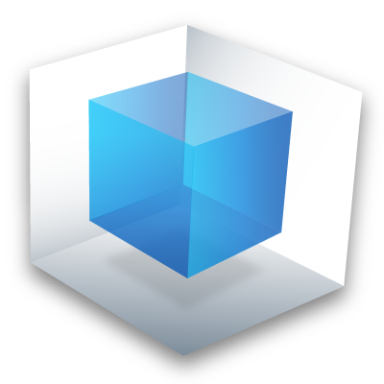
Blockchain of Blockchains
Governments Institutions
Finance & Banking
Industry Regulators
Private
Blockchains
Public
Blockchains

Slide 29
Supply Chain Management in Blockchain Era
Block 5
Blockchain Trailblazers in Supply Chain Management
www.bitnautic.io

Slide 30
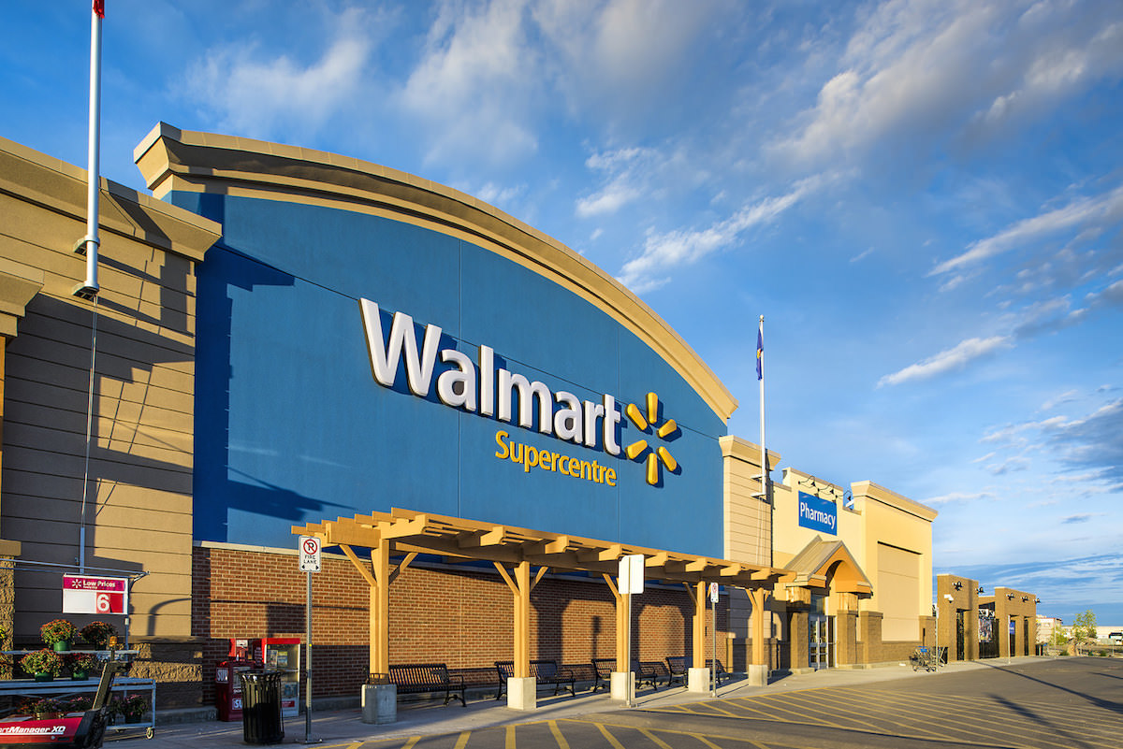
Walmart
Features of Blockchain System | Employees can track some products back to their roots—literally. After scanning mangoes or a couple dozen other products with the store's app, employees can see which farm the fruit came from and where it's stored in the backroom, according to the Wall Street Journal. The technology could help customers understand where their food comes from and could streamline the restocking process.

Slide 31
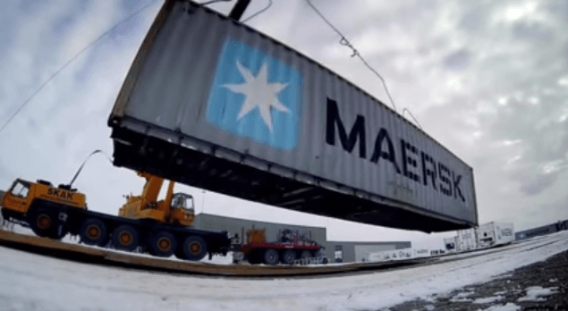
Maersk
Features of Blockchain System | The world's largest shipping company completed its first test of blockchain technology in March 2017, looking at how it could help manage its cargo. In the test, Maersk, Dutch customs, and US Homeland Security were all able to remotely access data about the cargo, suggesting the technology may streamline and secure international shipping.

Slide 32
British Airways
Features of Blockchain System | The airline tested using blockchain to manage data about flights between London, Geneva, and Miami in 2017. Using one unchangeable history source, the airline hoped to reduce conflicting flight information coming from gate monitors, flight apps, and the airline's website.

Slide 33
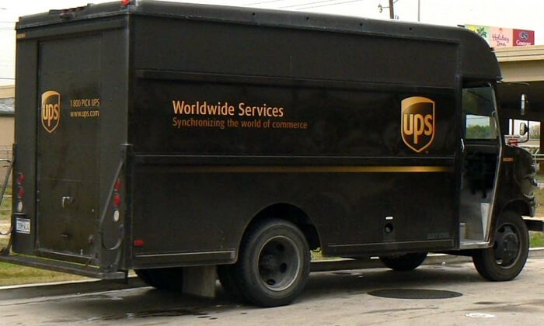
UPS
Features of Blockchain System | Joined the Blockchain in Trucking Alliance (BiTA) in Nov 2017, for increased transparency among all groups involved in the supply chain. The group is working to develop blockchain standards for the freight industry. "In the future, blockchain standards and intercompany collaboration will support the logistics strategies that enable UPS customers to participate in global trade and finance." UPS is also looking at how blockchain can be used in its customs brokerage business.

Slide 34
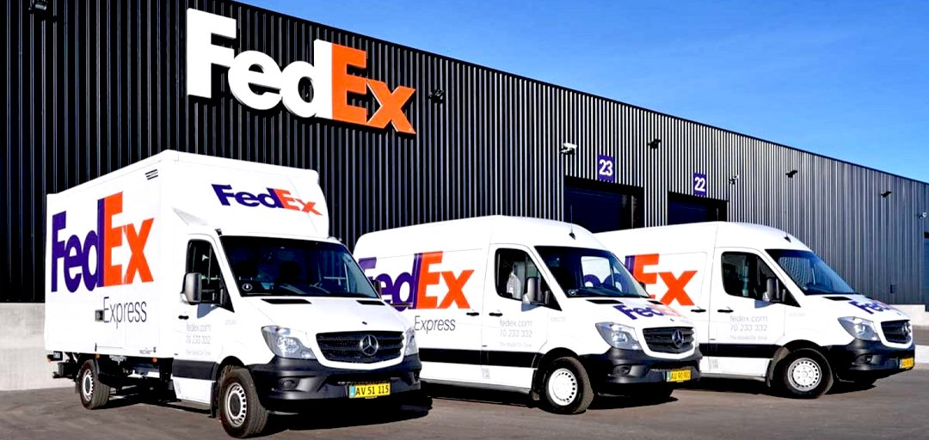
FedEx
Features of Blockchain System | FedEx, another shipping giant, joined BiTA in February 2018, and has already launched a blockchain-powered pilot program to help solve customer disputes. The company hopes the program will clarify what data should be stored on blockchain to best remedy customer issues. FedEx also hopes to use the technology to store records

Slide 35
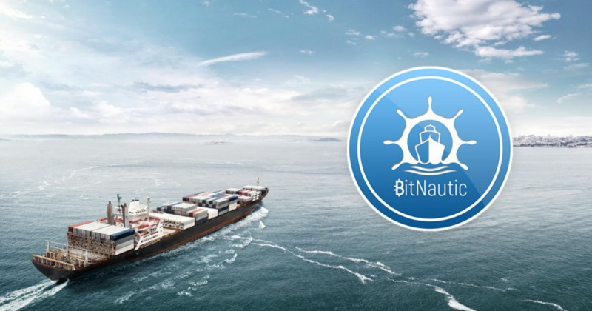
BitNautic
Features of Blockchain System | Users can use native BTNT as global shipping currency to exchange crypto & Fiat currencies with BTNT for using all the shipping ecosystem services. E-Commerce Platform for users to buy products & services of shipping industry. State of an art Tracking & Tracing System for ships and cargo. Platform for Cargo Booking & Other Intermediary Services.

Slide 36
Supply Chain Management in Blockchain Era
Block 6
What are Challenges for Supply Chain Management on Blockchain?
www.bitnautic.io

Slide 37
Blockchain Challenges for Islamic FinTech Stakeholders
Regulatory Uncertainty
Novelty
Heavily Forked
Lack of
Standardization
Bitcoin Blanket
Bubble Burst
Notes:
The “novelty” of such a technology makes it harder for people to understand the solution domain,
While its “complexity” requires a larger institutional change to foster an easy adoption.
Crossing the Bubble Burst
https://courses.edx.org/courses/course-v1:LinuxFoundationX+LFS171x+3T2017/courseware/4bdba5353739430592043585c7fbf044/db02e6d2659642fcaae23847166ddd9c/?activate_block_id=block-v1%3ALinuxFoundationX%2BLFS171x%2B3T2017%2Btype%40sequential%2Bblock%40db02e6d2659642fcaae23847166ddd9c
Separate Hype from Implementation Realities
Religious interpretations
Regulations to certain degree is critical
It may look like it defeats the purpose of decentralize currency
Too much of anything even love is not healthy
Balance would be “name of game” to protect the wider interest of public

Slide 38
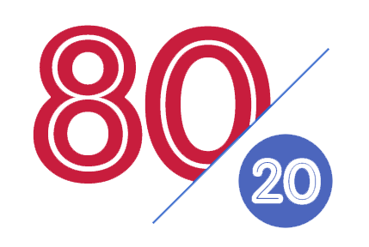
Approach for Implementing Blockchain in Supply Chain Management
Implementing the Blockchain is "80% Business Process / 20% Technology"
[it’s not the other way around]

Slide 39
Strategic Steps for Blockchain Application
Step 5: Scale your efforts appropriately
Step 4: Put your prototypes to work
Step 3: Explore feasibility and readiness
Step 2: Find specific opportunities
Step 1: Create a core technology working group
Think Big - Start Small - Act Fast

Slide 40
Supply Chain Management in Blockchain Era
Block 7
Chaining all Blocks
www.bitnautic.io

Slide 41
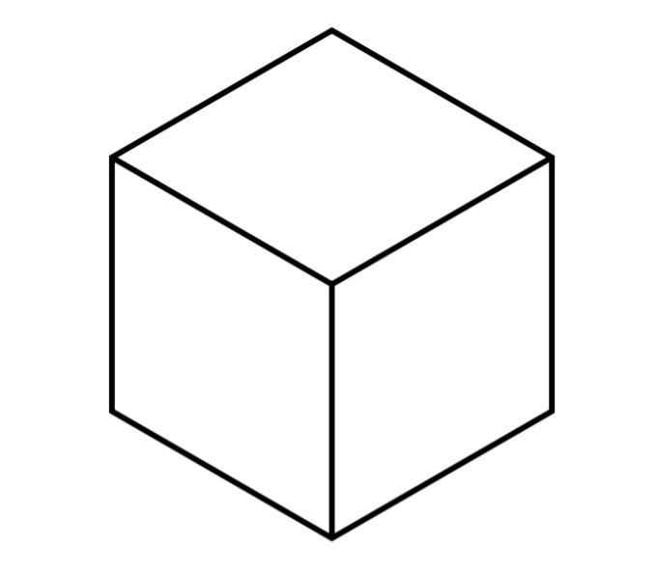
Chaining All Blocks: Review
Blockchain Challenges & Approach for Implementation
Blockchain Trailblazers in Supply Chain Management
Blockchain Applications in Supply Chain Management
Blockchain Benefits
Blockchain Orientation

Slide 42
If Supply Chain is Grass then Blockchain is Lawnmower
Notes:
We need grass mover – similarly we need regulator for monitoring the transactions on Blockchain

Slide 43
Supply Chain Management in Blockchain Era
Block 8
Q&A Session
www.bitnautic.io

Slide 44
Supply Chain Management in Blockchain Era
Block 9
Thanks!
Visit us at A-06
www.bitnautic.io

