Slide 1
RUNNING THE WORLD ON THE CLOUD
IMRAN KHAN
MANAGING DIRECTOR

Slide 2
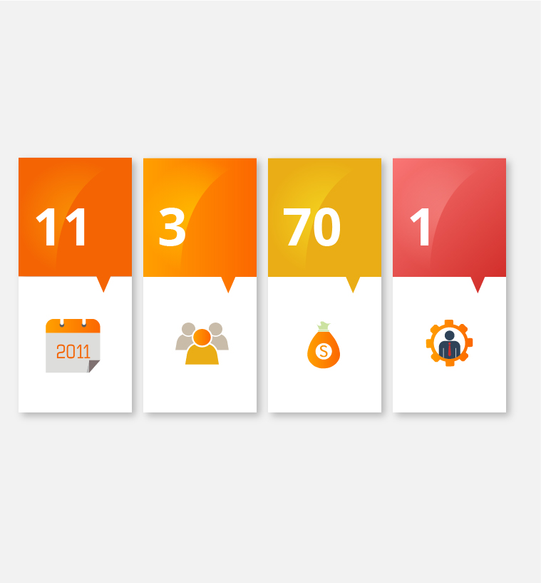
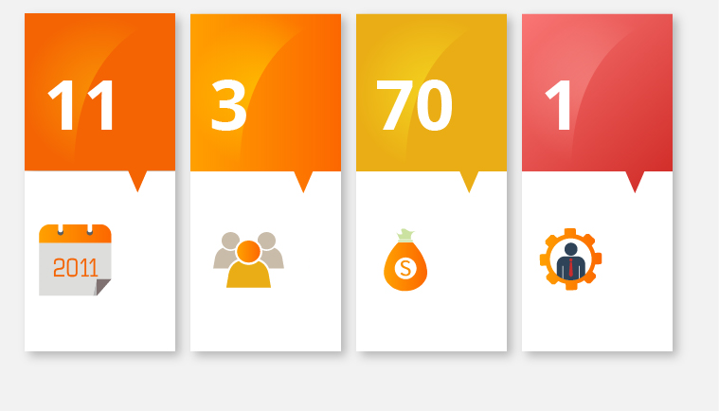

Slide 3
“We set out to establish RapidCompute as a state of the art Cloud Computing option with the same basic features and attention to detail as leading cloud providers internationally. The goal was to establish a Pakistani service for Pakistani companies to use and take advantage of.”
Zaeem Arshad
Founder RapidCompute

Slide 4
Our Legacy
First and the largest cloud service provider in the country
6 years in service
100% locally owned and operated

Slide 5
Our Legacy
4 x cloud enabled DataCentres in 2 geographies
Serving more than 500 customers today, across all industries
More than 5000 VMs active on our infrastructure
4 PB of storage in use by our customers
Defining Mission Critical

Slide 6
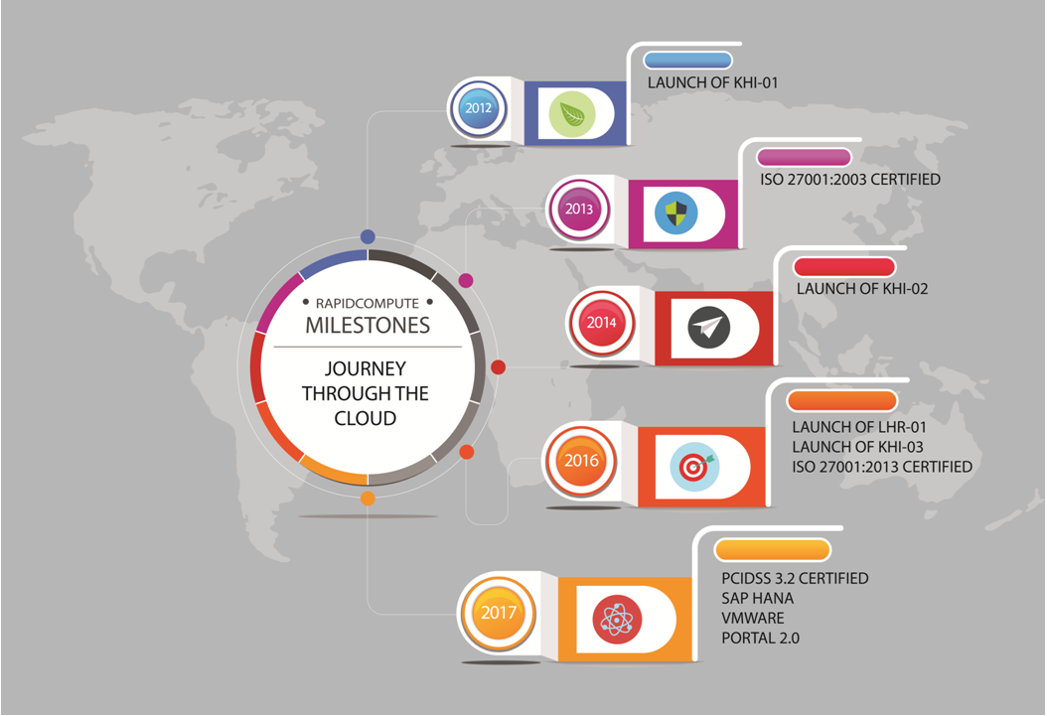

Slide 7
RapidCompute Today
All flash storage architecture available to all customers for high IOPS
Accounts for almost 30% of all deployments
SDN switching for 10/40 Gig network
Partnership with Dell, Huawei and SuperMicro for cutting edge infrastructure expansion and support

Slide 8
Hosting Mission Critical Workloads
Hosting of real time maps and navigation
Real time delivery, statistics and routing for one of the top courier companies
Production hosting of SAP, Microsoft Dynamics and large ERPs for some of the largest FMCGs

Slide 9
The RapidCompute way
Offers all flavors of billing key to the cloud experience (hourly & monthly)
Self-service user portal
Manageability and reporting of every activity in your hands and on your fingertips
Confidential – Do Not Share

Slide 10
The Cutting Edge
Fintech companies
Banking applications
Payment gateways
HSM and encryption modules
OTT and digital encoding
3D rendering
And much more
RapidCompute now hosts:
SAP workloads
Oracle
Microsoft portfolio
Homebrew ERP’s
HANA
BI/Analytics
CDN’s

Slide 11
The RapidCompute way
Local CSPs do not have many key aspects of an Enterprise Class cloud in place
Foreign CSPs cannot relate to importance of local entities along with latency issues
Customization and services prohibitively expensive on the likes of AWS and Azure
Ability to integrate key components like HSM, Security appliances e.t.c

Slide 13
2018- What’s in store?
RapidCompute StartSmart™ program
First SAP HANA enabled infrastructure on cloud
BI and analytics platforms
Multi hypervisor support
GPU on cloud

Slide 15
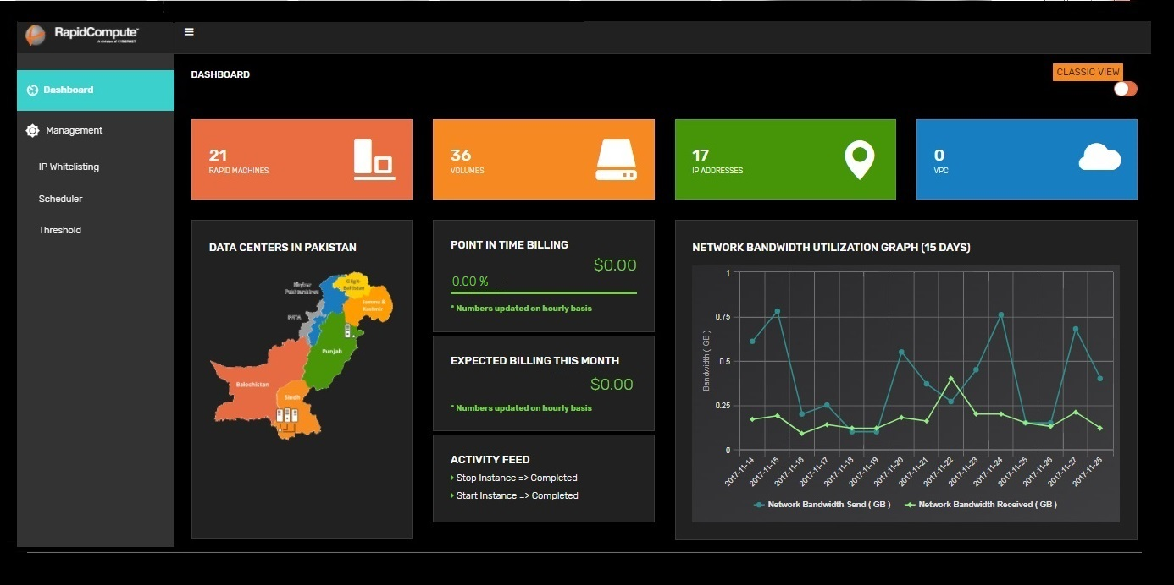
Revamped Customer Portal
Complete control of computing resources
Scheduler support
Quickly scale capacity
Manage security credentials
Track monthly spending and consumption in real time
Phone and Tablet optimized

Slide 16
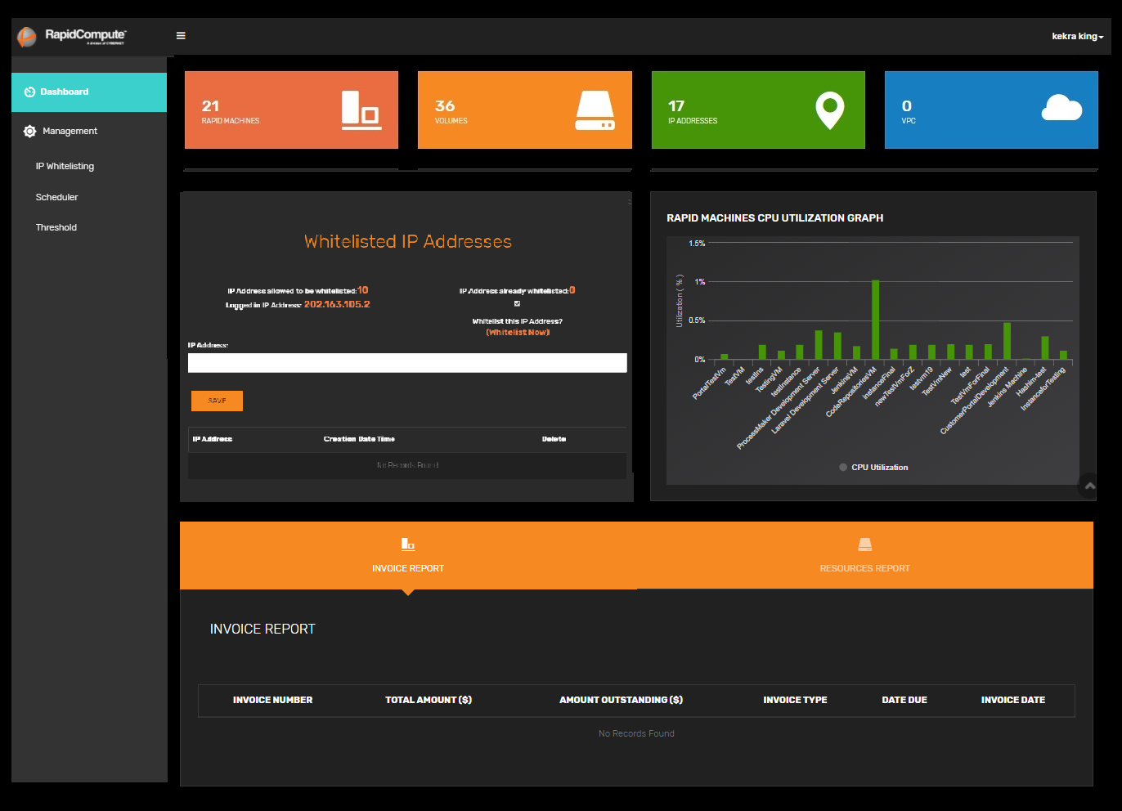

Slide 17
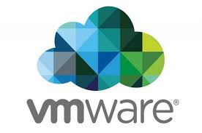
Vmware on RapidCompute
On-demand service to run VMware based applications on next generation infrastructure
Seamlessly integrate VMware defined data center technologies with the scalability, security and cost effectiveness of RapidCompute.

Slide 18
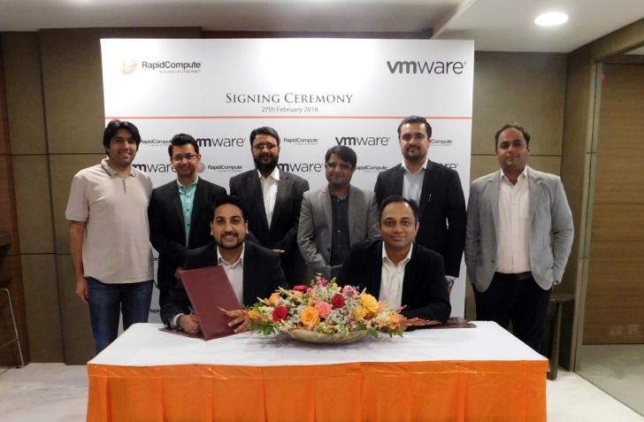
Migrate to RapidCompute without making any major changes to the way you operate in-house
Take advantage of existing internal VMware assets
Cut down costs through effective and efficient use of resources
Take advantage of scalable and flexible infrastructure
Simple and easy to deploy Hybrid could setup
Integrated with entire portfolio of RapidCompute services

Slide 19
Accelerate business processes
Deliver more business intelligence
Simplify IT environment
Optimize performance for data warehousing related applications.
Cost optimized options on long term contracts at a fraction of hardware costs

Slide 20
• Simplicity: driving quick deployment of SAP HANA in the cloud
•Certified running in SAP HANA certified architecture
• Optimization architected to support each customer’s landscape
• Innovation delivering a platform for innovation
• Peace of mind providing 24/7 support for infrastructure

Slide 21
Microsoft CSP / SPLA
Pair your products with the Microsoft products to create custom cloud solutions.
Offering all Microsoft Enterprise level solution on Pay As you Go Model at RapidCompute cloud
Products includes:
Office 365 on RapidCompute Cloud
Exchange 365
Dyanmics 365
SharePoint 365

Slide 22
FusionSphere
OpenStack based cloud platform designed through Huawei's deep understanding of the telecom industry, having created an open, agile, reliable cloud OS for enterprise and carrier customers to deploy private cloud, public cloud and hybrid cloud.
SAP HANA Certified Virtualization and Orchestration Platform.
Fusion Sphere Provides:
Block Storage API & Extensions
Compute Service API & Extensions
Metering & Data Collection Service API
Networking API & Extensions
Orchestration API

Slide 23
BI Analytics
A unique approach to hybrid data management helps you drive more value from your data
Leverage your most sensitive data in a security-rich environment
Governed analytics on an enterprise platform you can trust and access from anywhere
Self-service planning gives your teams the tools they need to steer your organization in the right direction

Slide 24
Modemetric
· Virtualize – Intelligence through Dynamic Metadata model eliminates need for data lakes or warehouses
· Harmonize – Drag and drop connectivity that prepares data from any source in real-time
· Visualize – Self-service for advanced, interactive reports and dashboards with Centralized Governance.
· Analyze – Embedded modeling for predictive analytics provides rapid time to insight for effective decisions and outcomes

Slide 25
GPU
Compute-focused GPUs
Tesla K80 Accelerators
High Speed Computing needs
Rendering on cloud
Video Analytics and processing

Slide 26
Cloud Management 2.0

Slide 27
“Ultimately, the cloud is the latest example of creative destruction: creating wealth for those who exploit it; and leading to the demise of those that don’t.”
Joe Weinman
Author of Cloudonomics: The Business Value
of Cloud Computing

Slide 28
Thank You

